Slide 1
Animal Welfare & Planetary Health
Why Caring for Animals Matters for Our Planet‘s Future
Mascha Kaddori
Planetary Health Summer School, 16.09.2025
Notes:
Disclaimer: when talking about „animals“ I‘m referring to non-human animals.
Language shapes our thinking and thinking changes our actions!

Slide 2
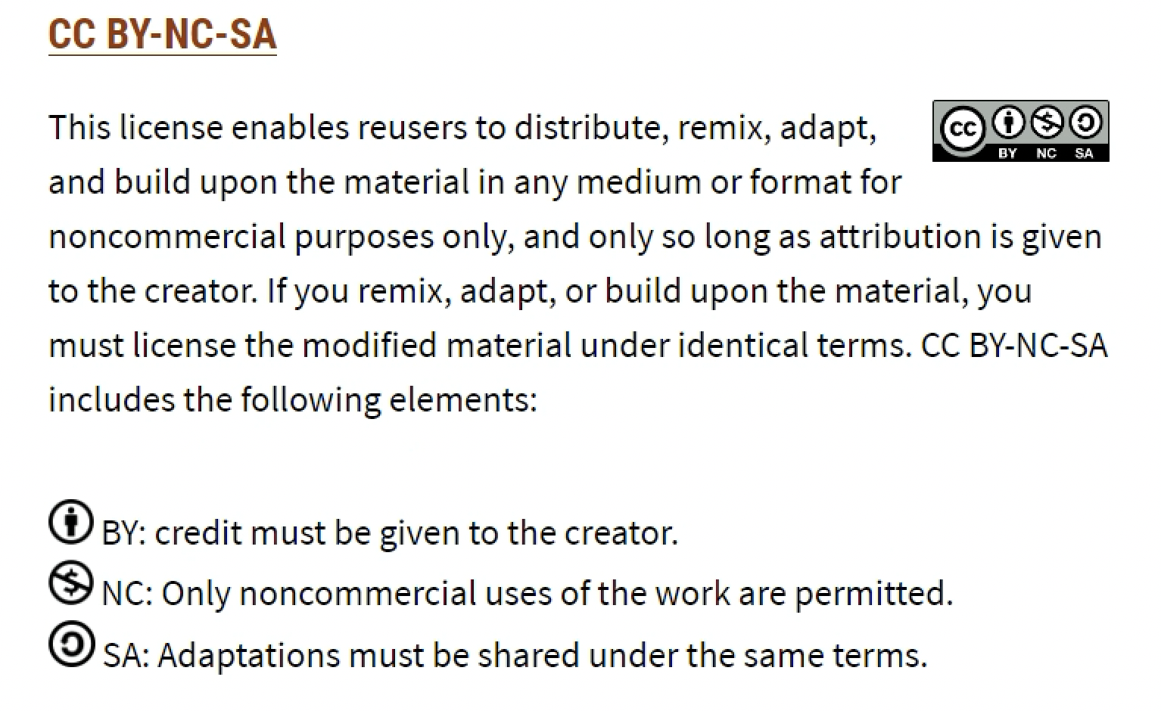
You may use the slides under the following Creative Commons license:
https://creativecommons.org/share-your-work/cclicenses/

Slide 3
What will we talk about?
Why Animal Ethics Belongs in Planetary Health
Positions in Animal Ethics in the Tension Between Humans, Animals, and the Environment
PH as an Ethical Project: What Does This Mean for Our Treatment of Animals?
Veterinary Responsibility in the Ethical Tension Field
Conclusion and Food for Thought
Notes:
Ethics is the branch of philosophy that studies what is right and wrong, good and bad, just and unjust in human conduct. It provides principles and frameworks to guide moral decision-making and evaluate actions, values, and intentions.

Slide 4
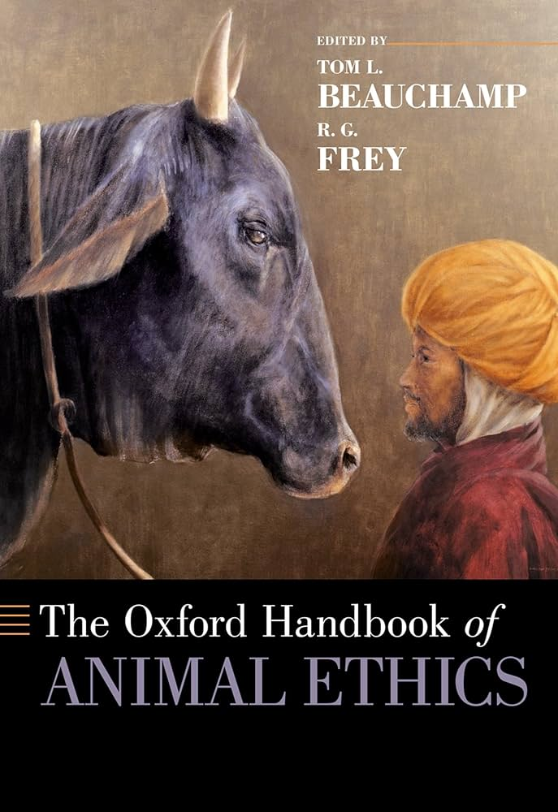
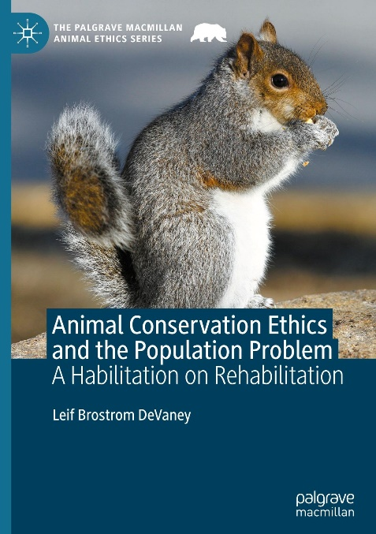
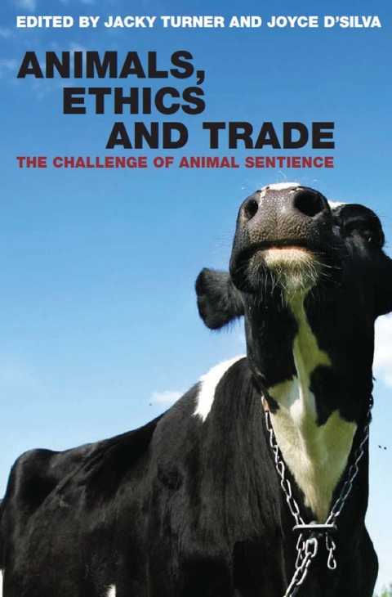
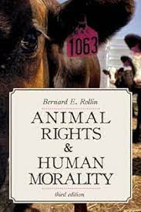
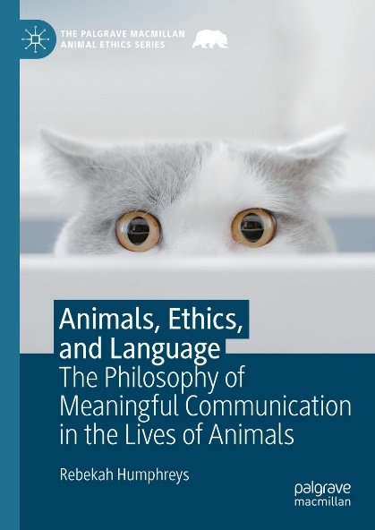
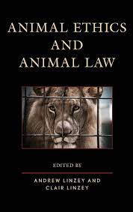
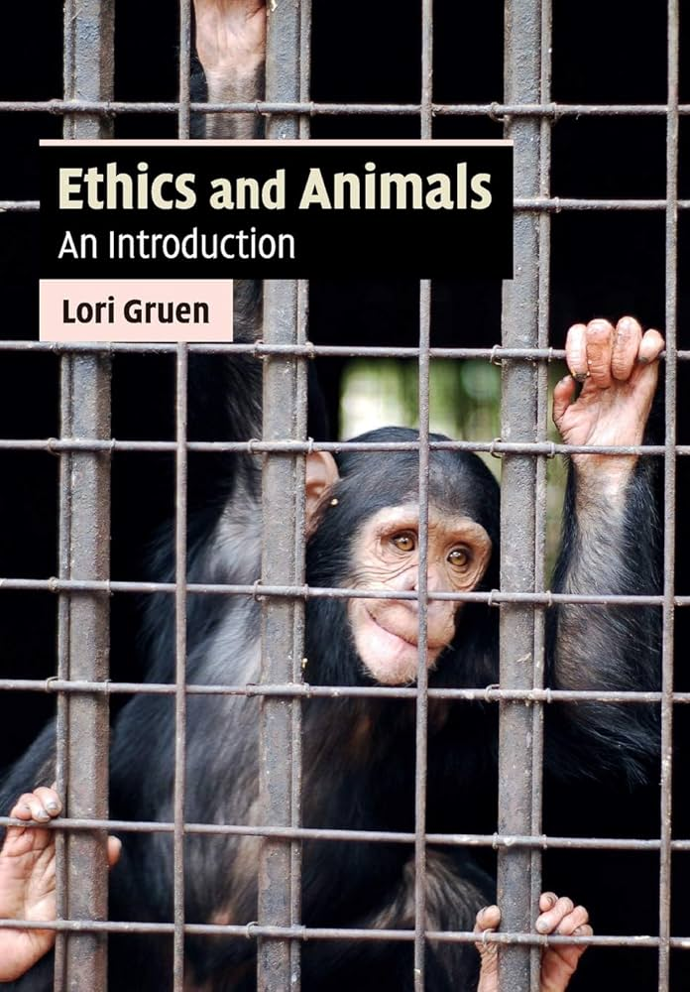
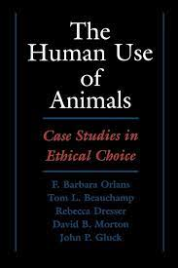
Why Animal Ethics Belongs in Planetary Health
Notes:
Planetary health is an interdisciplinary field that focuses on the health of human populations and the health of the Earth’s natural systems on which human life depends. It recognizes that human well-being, equity, and survival are inseparable from the stability of ecological systems such as the climate, biodiversity, water, and soil.
In short:
👉 Planetary health = human health + the health of the planet’s ecosystems.
It looks at how issues like climate change, deforestation, pollution, and biodiversity loss directly and indirectly affect human health, and emphasizes sustainable ways of living that protect both people and the planet.
Planetary Health emphasizes the interplay of human health, ecological integrity, and sustainability (Animals are not explicitly mentioned; are they sufficiently included in ecological integrity?).
Animals – especially farm animals, but also wild and companion animals – are a central element of ecosystems (Is this always made clear? Are they often simply framed as the problem – look at AMR, zoonotic diseases, pandemics – or considered in their own right?).
Animal ethics does not only ask: “How are the animals doing?” – but also “How should we treat animals?”
This adds a moral dimension to One Health/Planetary Health strategies.

Slide 5
Positions in Animal Ethics in the Tension Between Humans, Animals, and the Environment
Ethical Approaches | Focus | Significance for PH
Pathocentrism | suffering and well-being of sentient beings | emphasis on animal welfare, especially in intensive farming
Biocentrism | every life is worth protecting | protection of non-sentient animals/organisms, e.g. insects
Holism/Ecocentrism | on whole ecosystems | allows interventions for the sake of the system, even if individual animals suffer (e.g. wildlife regulation)
Animal rights approaches | animals have moral rights | fundamental critique of livestock farming and all forms of keeping (wild and companion animals), breeding, exploitation

Slide 6
PH as an Ethical Project: What Does This Mean for Our Treatment of Animals?
Farm animals and animal suffering
Companion animals – the blind spot?
PH emphasizes the environmental damage caused by industrial animal farming (emissions, water use, antibiotic consumption).
From an animal ethics perspective: intensive farming systematically violates animal welfare (lack of space, behavioral disorders, mutilations).
Ethical consequence: reduction in the consumption of animal products, promotion of animal-appropriate husbandry systems or alternative protein sources.
Feed requirements: global annual meat/feed consumption by dogs and cats (enormous CO₂ footprint).
Resource consumption: toys, litter, medical products, plastic packaging (ecological consumption style).
Exotic pet keeping: questionable husbandry for hobby reasons (snakes, monkeys, parrots, fish) – often involving wild capture, stress, and inadequate care.
Companion animals can enrich life emotionally, but their keeping is not automatically ethical or ecologically sound.
Notes:
Practical Applications of Animal Ethics
Farm animals/food systems & diets
industrial livestock production drives deforestation, climate change, and zoonotic disease risks, and AMR
companion animals
cats vs birds (wildlife/biodiversity): 20-100 million birds per year are killed by house cats in Germany
public health risk of importing stray animals from non-EU-countries into the EU
think the other way around: what is the impact of crossing planetary boundaries to non-human animals
change of vector-borne diseases effects host animals; warmer temperature can lead to „new“ diseases in certain regions that also affect non-human animals
non-human animals are directly affected by heat stress air pollution, water pollution, acidification of the oceans and deforestation

Slide 7
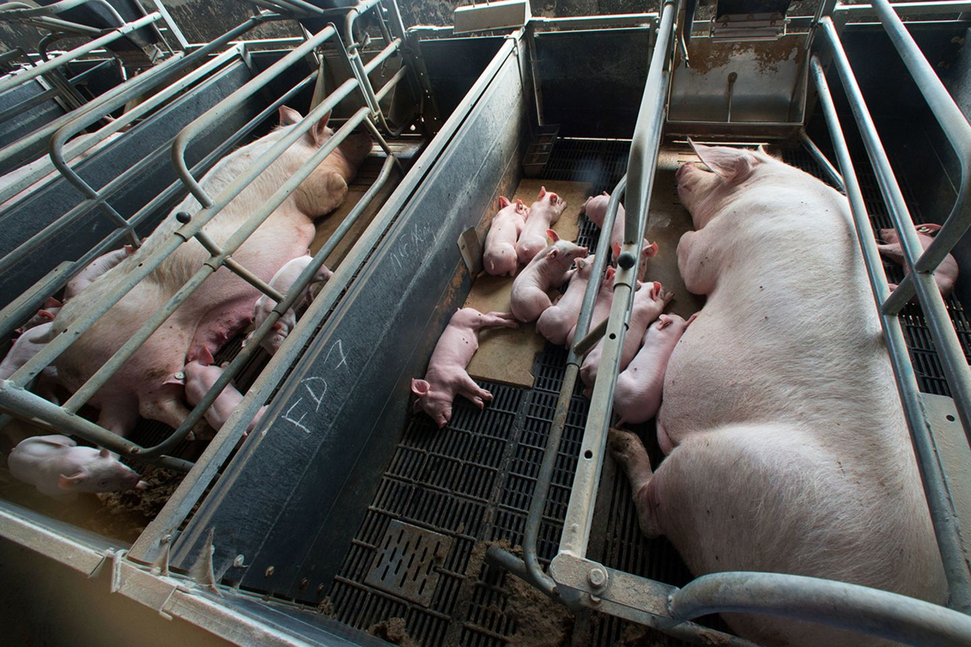
Gestation crates maximize control and space efficiency but have clear negative consequences for both welfare (behavioral and psychological suffering) and health (physical and physiological problems).
© Büttner/dpa/picture alliance
Notes:
Animal welfare and health implications of sow stalls/gestation crates:
Animal Welfare Implications
Severe movement restriction: Sows cannot turn around and can only stand up or lie down → frustration, stress, stereotypies (bar-biting, sham-chewing).
Behavioral deprivation: No ability to root, nest-build, or interact socially → compromised natural behaviors.
Mental health impact: Chronic stress, learned helplessness, and signs of reduced well-being.
Animal Health Implications
Physical problems: Pressure sores, injuries from bars, weakened muscles and bones due to lack of exercise.
Reproductive issues: Prolonged confinement can affect fertility and farrowing outcomes.
Gastrointestinal disorders: Higher risk of ulcers due to stress and restricted feeding.
Compromised immunity: Chronic stress may make sows more vulnerable to infections.
Number from industrial pig farming
Litter per year:
A breeding sow produces an average of about 2 to 2.5 litters per year.
Pigglet per litter:
In average around 13 pigglets per litter.
Pigglets per sow and year:
In average a sow raises 25 to 27 pigglets per year.
Gestation period:
The gestation period for a sow is approximately 114 to 115 days, which is about one third of a year.
Lifetime performance:
Over the course of her life, a sow gives birth to an average of four to five litters before she is slaughtered.
.

Slide 8
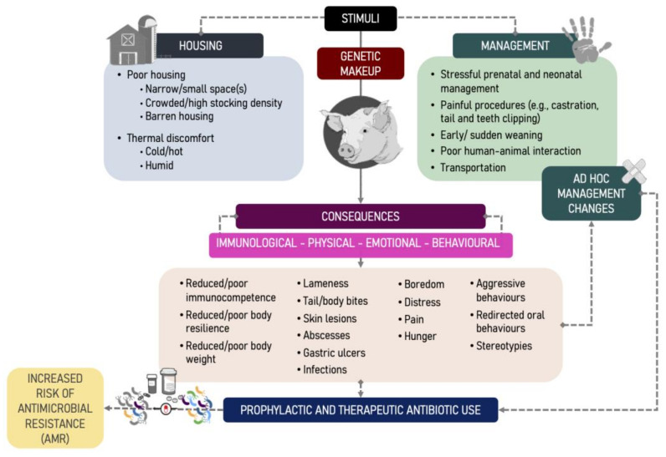
https://pubmed.ncbi.nlm.nih.gov/35049838/
Notes:
Poor animal welfare negatively impacts animal health by causing stress and increasing disease susceptibility, which in turn leads to a greater need for medication, potentially increasing antimicrobial resistance and requiring more complex treatments. This cycle highlights the interconnectedness of animal well-being and the efficacy of veterinary medications, as improved welfare can reduce disease incidence, thereby decreasing drug reliance and fostering responsible medication use
Figure 1 The biological pathway on how human-modulated stressors that challenge pigs’ immunological, physical, emotional, and behavioural status act as risk factors (direct/indirect) for antibiotic use (AMU) and antibiotic resistance (AMR) on farms. Lines indicate direct/indirect association, not the strength of association or causation. The observed AMU by the pig industry will be the sum of stressors and related management decision-making to proactively or reactively (e.g., ad hoc solutions) deal with such stressors. Literature and practical knowledge indicate that ad hoc management changes (e.g., cross-fostering or prophylactic antibiotic treatments) are quick fixes rather than rooted modifications. Thus, these management practices are equally risk factors of AMU/AMR in pigs.

Slide 9
PH as an Ethical Project: What Does This Mean for Our Treatment of Animals?
Farm animals and animal suffering
Companion animals – the blind spot?
PH emphasizes the environmental damage caused by industrial animal farming (emissions, water use, antibiotic consumption).
From an animal ethics perspective: intensive farming systematically violates animal welfare (lack of space, behavioral disorders, mutilations).
Ethical consequence: reduction in the consumption of animal products, promotion of animal-appropriate husbandry systems or alternative protein sources.
Feed requirements: global annual meat/feed consumption by dogs and cats (enormous CO₂ footprint).
Resource consumption: toys, litter, medical products, plastic packaging (ecological consumption style).
Exotic pet keeping: questionable husbandry for hobby reasons (snakes, monkeys, parrots, fish) – often involving wild capture, stress, and inadequate care.
Companion animals can enrich life emotionally, but their keeping is not automatically ethical or ecologically sound.
Notes:
1. Feed Requirements
Globally, dogs and cats consume an enormous amount of meat each year. This demand translates into a significant need for livestock feed, land use, and water, as well as greenhouse gas emissions. The carbon footprint of pet food is substantial — in some countries, the meat consumption of companion animals is comparable to that of millions of people. While pets are valued family members, their dietary needs highlight the tension between individual care and planetary sustainability.
2. Resource Consumption
Beyond food, companion animals require a wide range of products: toys, scratching posts, cages, bedding, cat litter, veterinary medicines, and grooming supplies. Most of these come with plastic packaging and are part of an ecologically costly consumption pattern. The production, transport, and disposal of these items contribute to pollution and resource depletion, making pet keeping a lifestyle factor with environmental implications.
3. Exotic Pet Keeping
The keeping of exotic animals such as snakes, monkeys, parrots, or ornamental fish raises both ethical and ecological concerns. Many of these animals are sourced through wild capture, contributing to biodiversity loss and illegal wildlife trade. Even when bred in captivity, their complex physical, social, and psychological needs are often difficult to meet in private households. Stress, improper diets, and inadequate housing are common, turning hobbyist practices into welfare challenges.
4. Ethical Ambivalence
Companion animals clearly enrich human lives by providing emotional support, companionship, and social bonds. However, their keeping is not automatically ethical or ecologically sound. A responsible approach to pet ownership requires considering the ecological footprint, the animal’s welfare, and the broader impacts on ecosystems and societies.
Keeping a pet often provides strong mental health benefits for humans — companionship, reduced loneliness, emotional support, and stress relief. However, the balance is not always equal for the animal. While some pets enjoy close interaction, safety, and stimulation, others may experience stress, boredom, social deprivation, or even suffering if their needs are not met. This creates an imbalance of mental benefits, where humans gain more than the pet does, highlighting the ethical responsibility to ensure that animal welfare and emotional well-being are genuinely respected.

Slide 10
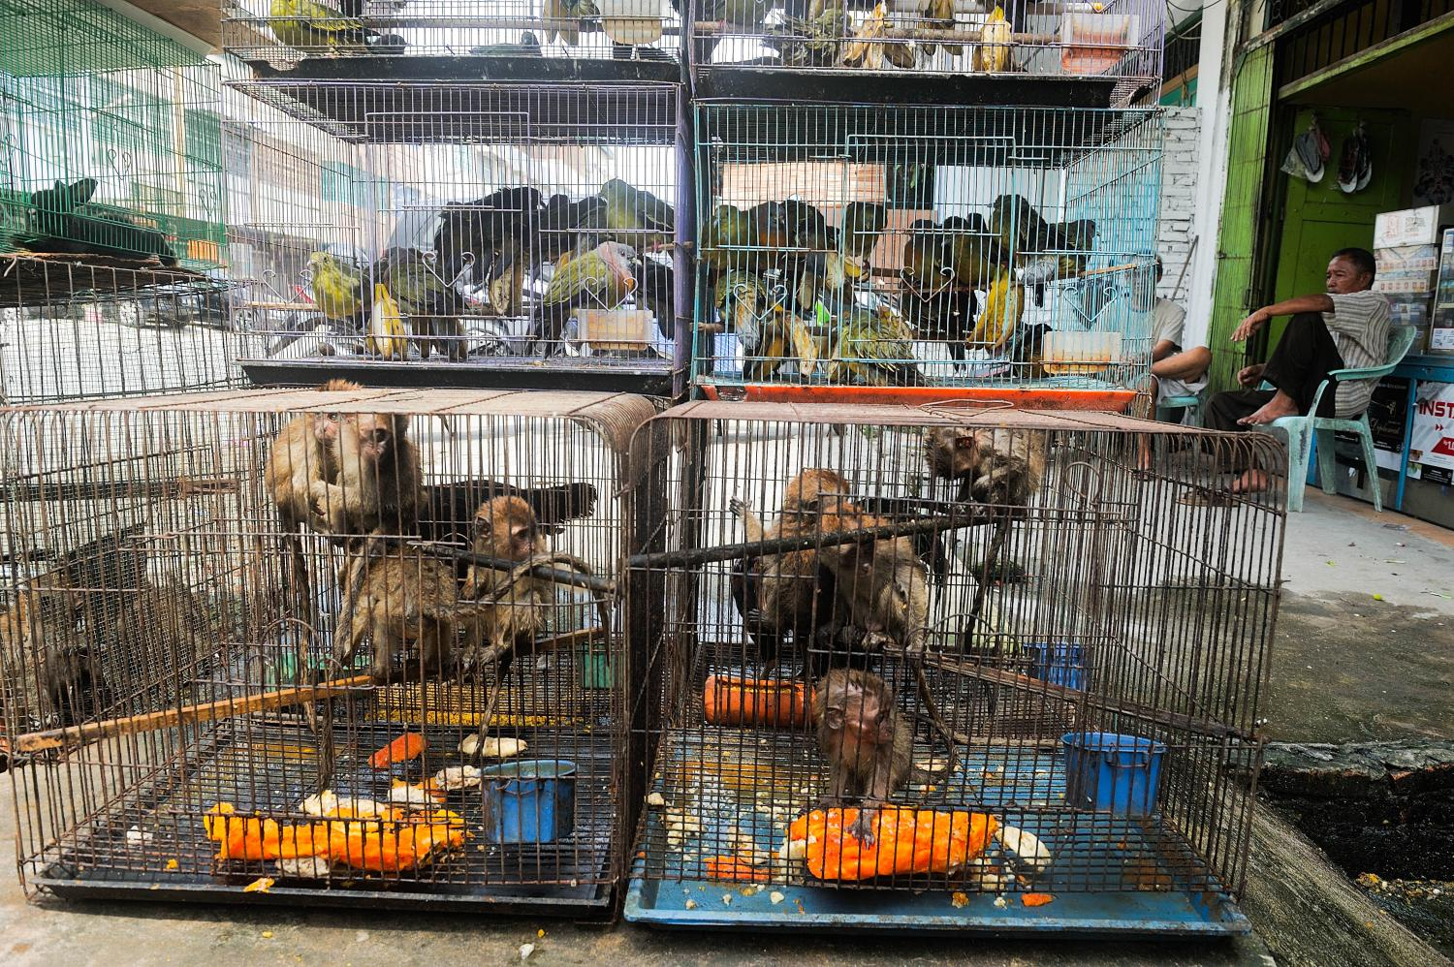
https://www.cambridge.org/core/journals/cambridge-prisms-extinction/article/trading-species-to-extinction-evidence-of-extinction-linked-to-the-wildlife-trade/09F38911BB76B0561056D96A5E60A341
https://www.brookings.edu/articles/preventing-pandemics-through-biodiversity-conservation-and-smart-wildlife-trade-regulation/
Notes:
Preventing pandemics through biodiversity conservation and smart wildlife trade regulation
Wildlife-pet markets, although standalone phenomena, also have ties to the endpoints of wider relevant issues, including anthropogenic habitat loss, ecological disturbance, encroachment, globalization, transport facilitation, trade, wildlife capture, captive-breeding, culinary habits, and wildlife-pet keeping. These elements involve a range of negative factors from poorly moderated introductions of humans to atypical environments, through to removal of wildlife from ecologically stable systems, to placement of animals into abnormal conditions of captivity in commerce and the home. Individually and cumulatively, these factors, and the diversity of divisional elements within each, probably constitute the primary causes of suffering, morbidity, and mortality among wildlife-pet animals and the emergence of wildlife-associated human and agricultural epidemics and pandemics.

Slide 11
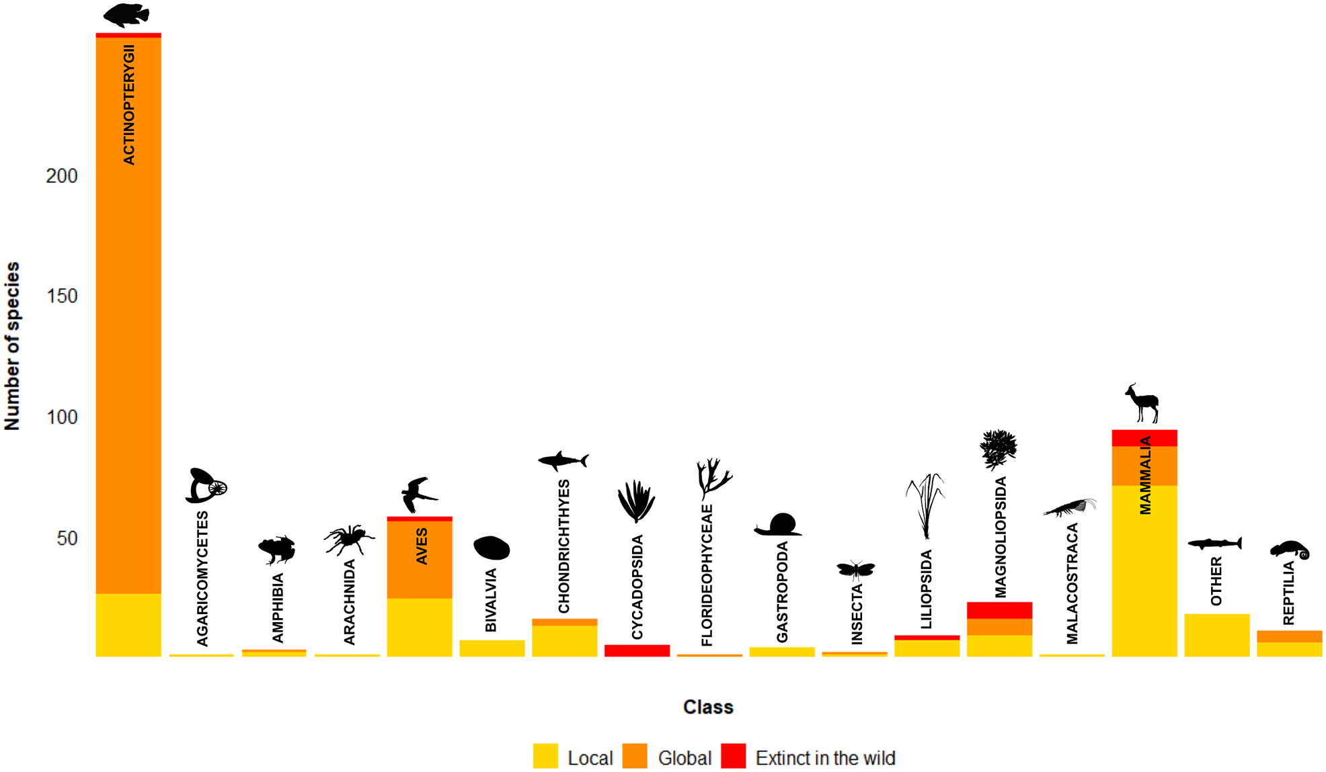

https://www.cambridge.org/core/journals/cambridge-prisms-extinction/article/trading-species-to-extinction-evidence-of-extinction-linked-to-the-wildlife-trade/09F38911BB76B0561056D96A5E60A341
Notes:
Figure 1. Species reported to have gone extinct due to trade or harvest for trade, by class. Based on the literature reviewed and species categorised as Extinct on the IUCN Red List of Threatened Species Version 2022-1.

Slide 12
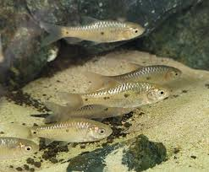
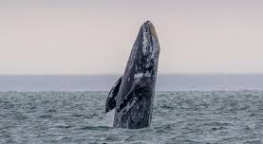
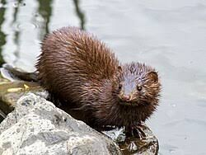
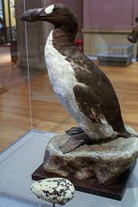
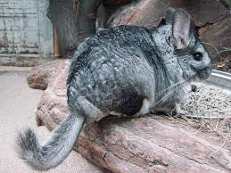
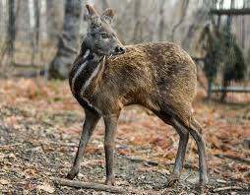
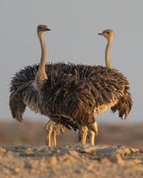
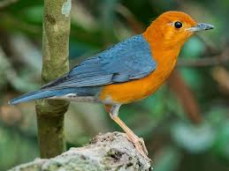
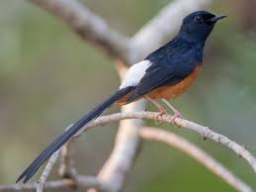
Notes:
Figure 1. Species reported to have gone extinct due to trade or harvest for trade, by class. Based on the literature reviewed and species categorised as Extinct on the IUCN Red List of Threatened Species Version 2022-1.
- Similarly, 15 Barbodes species (fish species) in the Philippines became extinct, partly due to introduced predatory fish and unsustainable fishing
- Mammal extinction: Several were linked to trade following European colonisation of islands in the 1800s, such as sea mink hunted for the fur, and the great auk (large, flightless seabird) hunted for multiple products and for scientific specimens.
- The 71 reported local extinctions of mammals linked to trade included small taxa such as the long-tailed chinchilla reportedly hunted to extinction in several areas of Chile for its fur, musk deer hunted for traditional medicine trade in China, and multiple reports of local extinctions of grey whales.
- The 24 reported local bird extinctions ranged from ostriches in Syria due to hunting and commercial feather collecting, to songbirds like the orange-headed thrush and white-rumped shama, collected for the live bird trade in Indonesia.

Slide 13
PH as an Ethical Project: What Does This Mean for Our Treatment of Animals?
Wild animals and biodiversity
Animals as co-inhabitants, not resources
Wild animal suffering due to habitat loss, climate change, hunting, traffic, etc.
Veterinary roles include rehabilitation centers, wildlife vaccination programs, reintroduction projects (e.g. Przewalski’s horses in Kazakhstan).
Ethical debate: Should humans intervene? Must humans intervene?
An animal ethics perspective calls for a shift in relationship from “resource object” to “co-inhabitant.”
PH/OH provides a platform for a systemic re-evaluation of the animal world.
Notes:
PH requires preserving ecosystems and species diversity
animal ethics strengthens this by insisting that individual wild animals also deserve moral consideration, not just species or ecosystems
From an animal ethics perspective, animals should no longer be viewed merely as resources for human use, but as co-inhabitants with intrinsic value and rights to well-being. Within the Planetary Health/One Health (PH/OH) framework, this shift gains a systemic dimension: animals are recognized as integral parts of shared ecosystems, whose health and dignity are directly linked to human and planetary health. This re-evaluation challenges exploitative practices and supports more just, sustainable, and compassionate ways of coexisting.

Slide 14
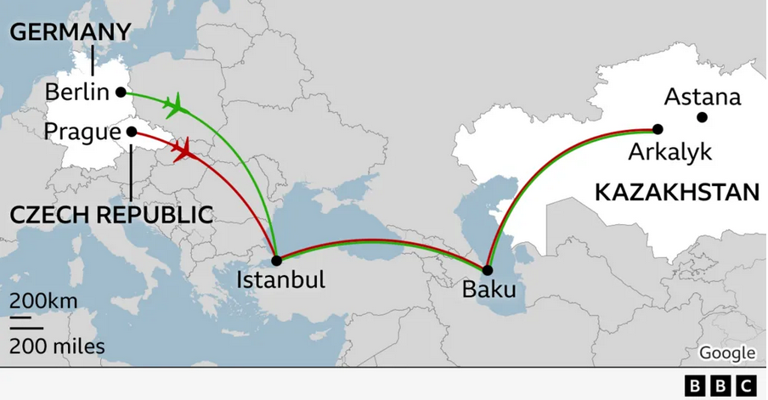
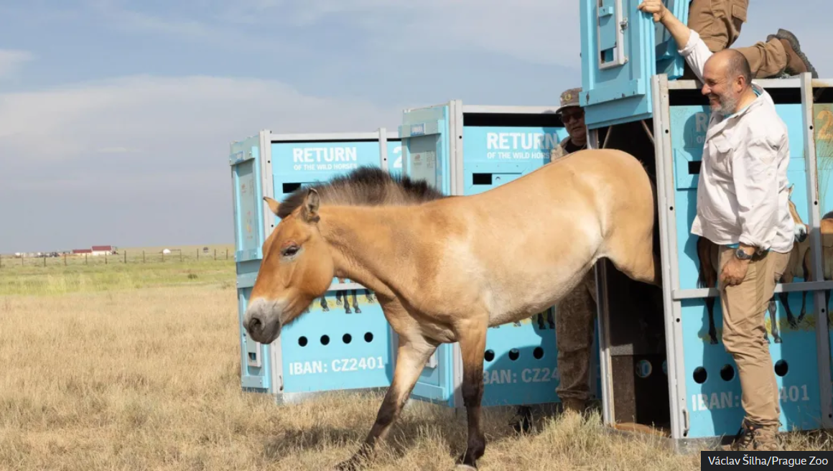
Example of humans trying to re-create natural, healthy ecosystems
Przewalski’s horses are the last truly wild horse species; they went extinct in the wild by the 1960s.
Notes:
Key Facts
Przewalski’s horses, an endangered wild horse species, have been reintroduced to Kazakhstan’s Golden Steppe for the first time in at least 200 years.
The reintroduction happened in early June, when seven horses (one stallion, six mares) were airlifted from Europe in a project led by Prague Zoo.
Before the release into the wild plains, they will spend about a year in a 60-hectare acclimatisation pen to adjust.
Background & Significance
Przewalski’s horses are the last truly wild horse species; they went extinct in the wild by the 1960s.
In recent decades, there have been efforts to reintroduce them in Mongolia and China. The Kazakhstan reintroduction marks their return to one of their ancestral homelands.
The reintroduction is part of long-term conservation work, including breeding programmes in European zoos.
Outcomes & Hopes
The horses are reported to be doing well two weeks after release: exploring the plains and even starting to mate.
The goal of the project is to bring more individuals over time — at least 40 more in the next five years.
The initiative is meant not just to restore a species but to restore it in its native ecosystem, helping to reverse the effects of past human-driven decline.

Slide 15
Ecological Roles of Wild Horses
Grazing & Vegetation Management
They are large grazers, shaping steppe and grassland ecosystems by consuming grasses and herbs.
Their selective grazing helps maintain plant diversity, preventing a few species from dominating.
Seed Dispersal
By eating fruits and grasses, they spread seeds via dung, aiding plant regeneration and distribution.
Soil Fertility
Horse dung enriches soils with organic matter and nutrients.
Dung also supports invertebrates (e.g., dung beetles), which in turn sustain birds and other wildlife.
Habitat Creation for Other Species
Grazing creates a mosaic of vegetation heights, benefiting insects, ground-nesting birds, and small mammals.
Their trails can open up paths that other species use.
Food Web Contribution
Carcasses of wild horses provide food for scavengers and predators.
Historically, they were prey for wolves and other large carnivores, helping regulate predator-prey dynamics.
Notes:
When humans attempt to re-introduce formerly extinct species into ecosystems (a process called rewilding or de-extinction), they face a major challenge: ecosystems are complex and dynamic, and we often don’t fully understand why the species disappeared in the first place.
The extinction might have been caused by multiple, interacting factors such as disease, predators, competition, climate shifts, or human activities.
Even if one main driver (e.g., hunting) has been removed, other factors may still remain or new ones may have emerged (e.g., habitat fragmentation, invasive species).
As a result, re-introduced species may struggle to survive, or they may disrupt the ecosystem in unexpected ways — sometimes even harming existing species or destabilizing ecological balances.
In short: because ecosystems are complex and ever-changing, humans rarely know the full set of causes behind extinction, making re-introduction efforts uncertain and risky.

Slide 16
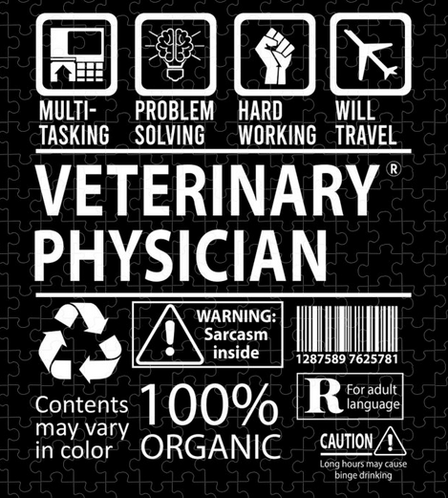
Veterinary Responsibility in the Ethical Tension Field
Veterinarians are not only practitioners but also ethical actors.
Their decisions influence:
  Animal individuals (treatment, euthanasia, breeding advice)
  Environment (use of medication, advice on husbandry systems)
  Society (consumer education, policy recommendations)

Slide 17
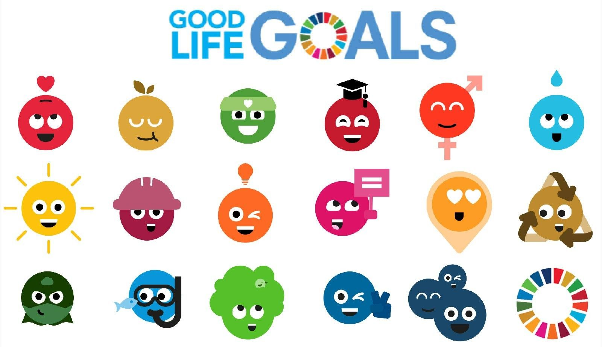
Conclusion and Food for Thought
Animal ethics and PH overlap: both ask about a good life – for all participants in the ecosystem.
Notes:
Challenge: finding an ethics that is not only ecologically effective but also just toward sentient beings.
In short: Animal ethics can enrich the planetary health framework by ensuring that solutions to global health and environmental challenges also respect the moral status and welfare of non-human animals. This makes planetary health not only about humans living well on Earth, but about all beings flourishing together.

Slide 18
Thank you for listening!
Mascha Kaddori
Email: mkaddori@gmail.com

Slide 19
Thought Experiment: Meat Yield

Slide 20
Wanna eat beef or chicken?
Category | Beef (beef cattle) | Chicken (broiler chicken)
Rearing time | 18-24 months | ~ 42 days
slaughter weight | 600-750kg live weight | 2-2.5kg live weight
meat yield | 40-45% of live weight | 65-70% of live weight
meat amount | 250-300kg per animal | 1.4 - 1.8kg per animal
Notes:
Planetary Health lense when looking at meat production:
Raising chickens for meat is generally more environmentally friendly than raising cattle because chickens require less land, water, and feed and they produce far fewer greenhouse gas emissions per kilogram of meat. Cows, as ruminants, emit large amounts of methane and need significantly more resources, making beef one of the most resource-intensive animal proteins compared to poultry.

Slide 21
How many chickens for one cow?
1 chicken (1.6 kg meat)
in ~ 6 weeks
1 cow (275 kg meat)
275 kg meat
172 chickens, each 1.6kg
in ~ 24 month
Notes:
Implications: Chickens reach slaughter weight in a fraction of the time → massive differences in land use, feed conversion, greenhouse gases, etc. in favor of chickens.

Slide 22
Ethical Question
Individual suffering per chicken is often greater (confinement, short lifespan, aggressive breeding).
Industrial chicken farming often has poorer welfare standards.
More individual animals have to die (1 cow vs 172 chickens) to get the same amount of meat.
Notes:
Animal ethics lense

Slide 23
Ethical consideration of potential life
Natural life expectancy:
Cow: 15–20 years
Chicken: 6–10 years
  172 chickens x 6 years = 1,032 years
Is it wrong not only because we end their current life, but also because we deprive them of their "potentially lived life" — the life they could have had if allowed to continue?
Notes:
The concept of "potentially lived life" in animal ethics is used to evaluate the moral weight of depriving an animal of the chance to live out its natural lifespan and experiences.
It highlights that animals don’t just have an interest in avoiding suffering, but also an interest in experiencing positive states — like social interaction, play, exploration, and nurturing behaviors.
When animals are killed prematurely (e.g., farmed animals slaughtered young, or laboratory animals euthanized), they lose the future goods of life they could have experienced.
Ethically, this raises the question: Is it wrong not only because we end their current life, but also because we deprive them of their "potentially lived life" — the life they could have had if allowed to continue?

