Slide 1
Introduction to One Health
These slides were generously donated to the SOPHEA project by
Melvine Otieno (SOPHEA Team)
Institution
11: 09/2025

Slide 2
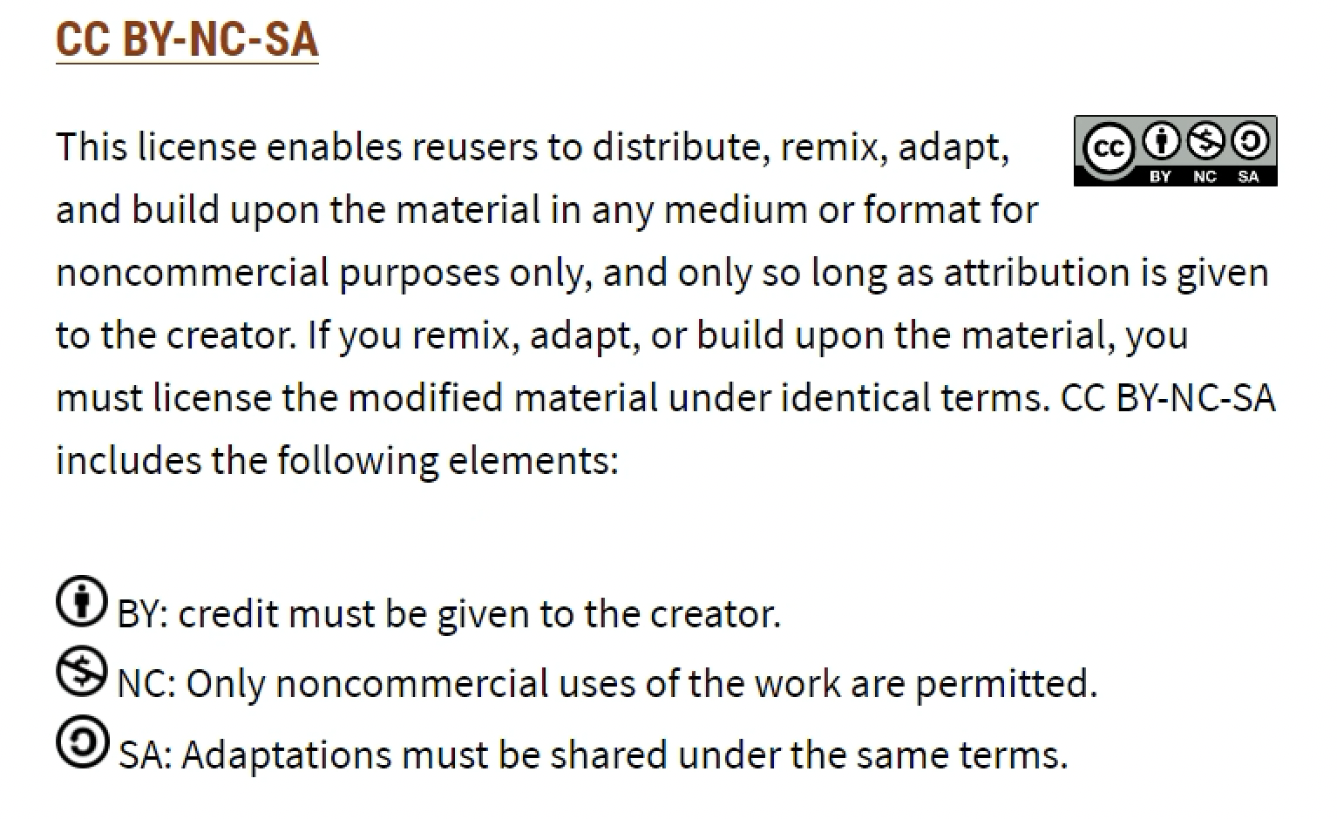
You may use these slides under the following Creative Commons license:
https://creativecommons.org/share-your-work/cclicenses/

Slide 3
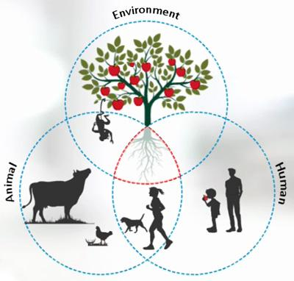
Overview
Introduction
Evolution of one health
One health approach foundation
One health issue
  Zoonotic diseases
  Antimicrobial resistance
  Food safety and food security
Veterinarians in one health
Environment in one health
Challenges and way forward
Conclusion
References

Slide 4
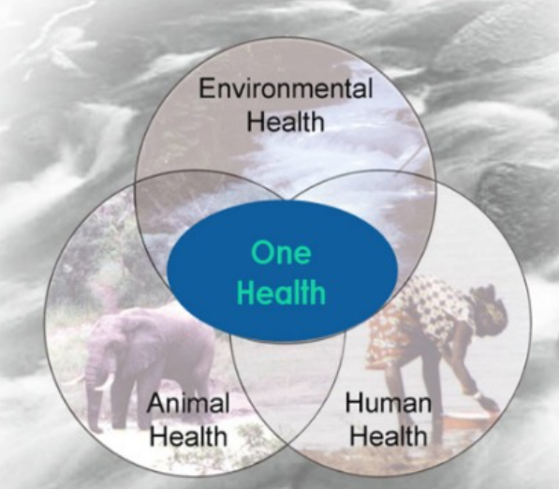

Introduction
One Health is a “collaborative, multisectoral, and transdisciplinary approach—working at the local, regional, national, and global levels—with the goal of achieving optimal health outcomes recognizing the interconnection between people, animals, plants, and their shared environment ”.
OHHLEP, 2021
https://www.who.int/publications/m/item/one-health-high-level-expert-panel-annual-report-2021
Notes:
The causes, mechanisms and impacts of these systemic challenges involve humans, animals, environments, plants…
“ One Health is an integrated, unifying approach…to sustainably balance and optimize the health of people, animals and ecosystems.
It recognizes the health of humans, domestic and wild animals, plants, and the wider environment (including ecosystems) are closely linked and interdependent.
The approach mobilizes multiple sectors, disciplines and communities to tackle threats to health and ecosystems, while addressing the … need for clean water, energy and air, safe and nutritious food, climate change, and sustainable development.”

Slide 5
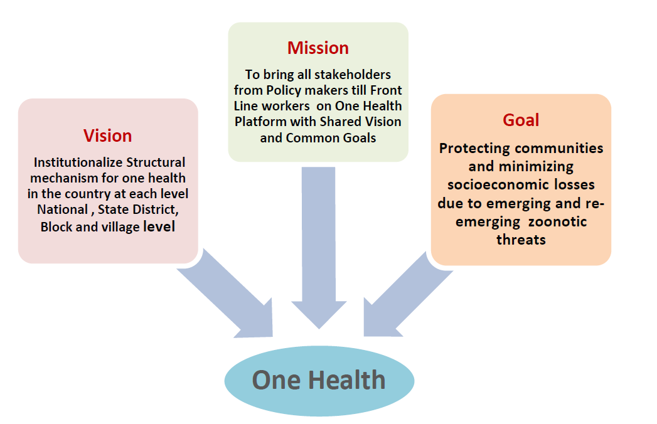

Slide 6
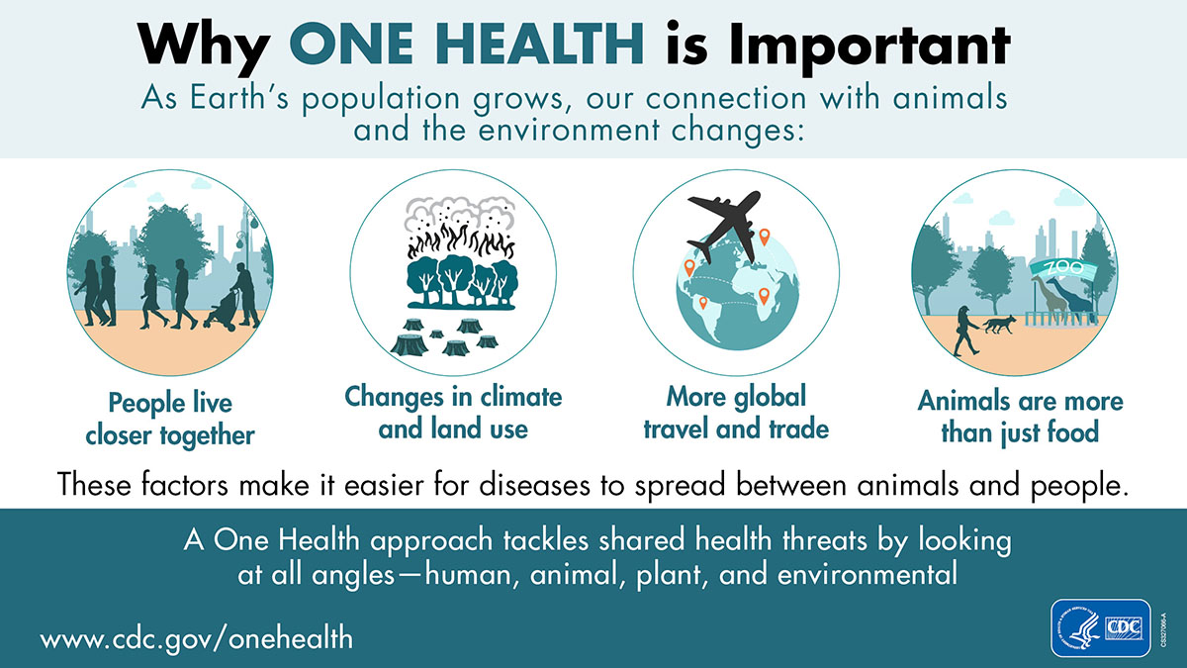
Notes:
Human populations are growing and expanding into new geographic areas. As a result, more people live in close contact with wild and domestic animals, both livestock and pets. Animals play an important role in our lives, whether for food, fiber, livelihoods, travel, sport, education, or companionship. Close contact with animals and their environments provides more opportunities for diseases to pass between animals and people.
The earth has experienced changes in climate and land use, such as deforestation and intensive farming practices. Disruptions in environmental conditions and habitats can provide new opportunities for diseases to pass to animals.
The movement of people, animals, and animal products has increased from international travel and trade. As a result, diseases can spread quickly across borders and around the globe.

Slide 7
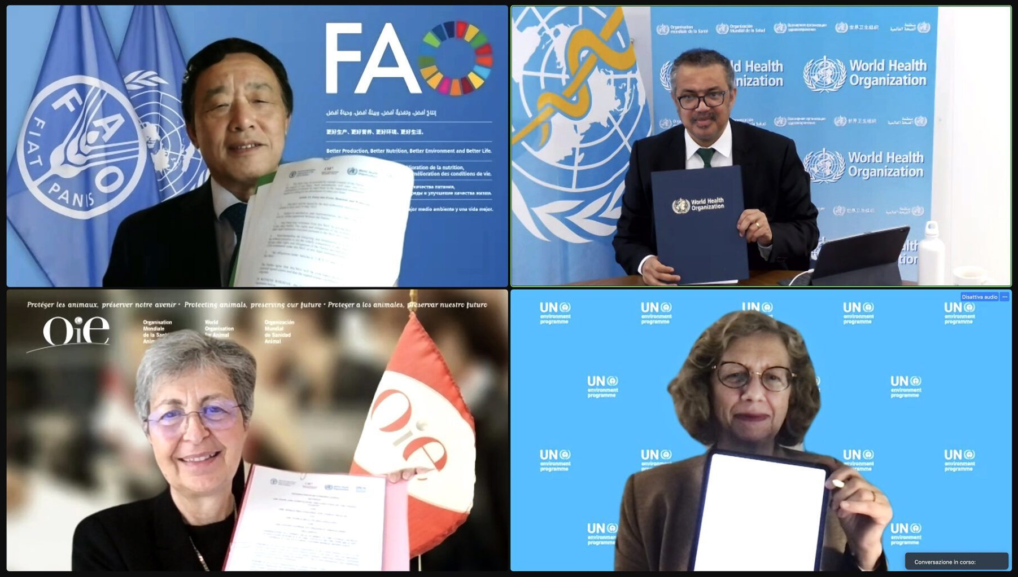
Introduction cont’
The One Health Approach gained popularity in zoonotic public health emergencies such as the outbreaks of severe acute respiratory syndrome, Middle East Respiratory Syndrome, H1N1 influenza, Ebola, and Zika.
One Health is also prominent in several global commitments and political declarations such as the Sustainable Development Goals, the International Health Regulations, the Global Health Security Agenda, the UN Paris Agreement on climate change, and the UN Political Declaration on Antimicrobial Resistance.
It forms the basis of the tripartite alliance of WHO, the Food and Agriculture Organization of the United Nations, and the International Organization for Animal Health.

Slide 8
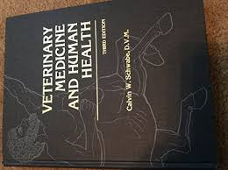
Evolution of One Health
1821-1902: Rudolf Virchow Recognizes the Link Between Human and Animal Health
1849-1919: William Osler, Father of Veterinary Pathology. first publications was titled, “The Relation of Animals to Man.”
1947 : The Veterinary Public Health Division is Established at CDC
1927-2006: Calvin Schwabe Coins the Term “One Medicine” and Calls for a Unified Approach Against Zoonoses That Uses Both Human and Veterinary Medicine

Slide 9
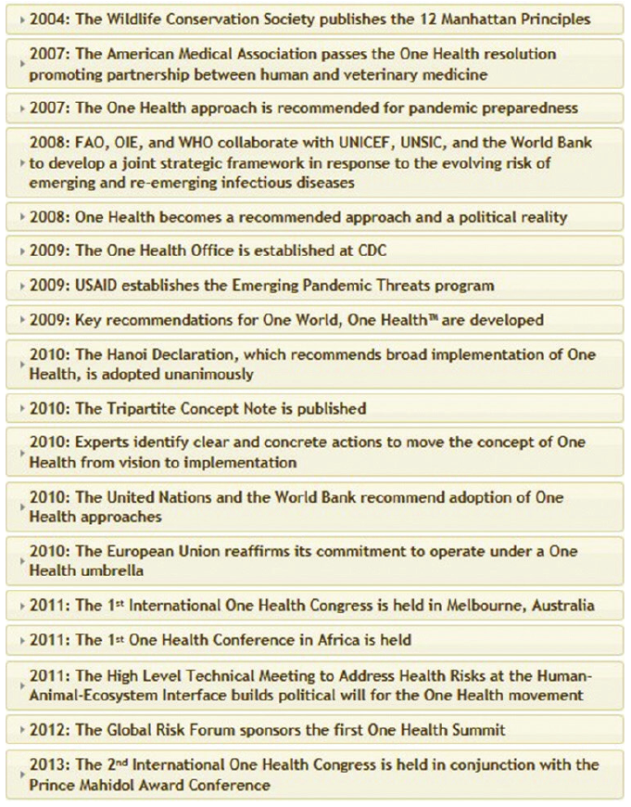
Evolution of One Health

Slide 10
Evolution of One Health

Slide 11
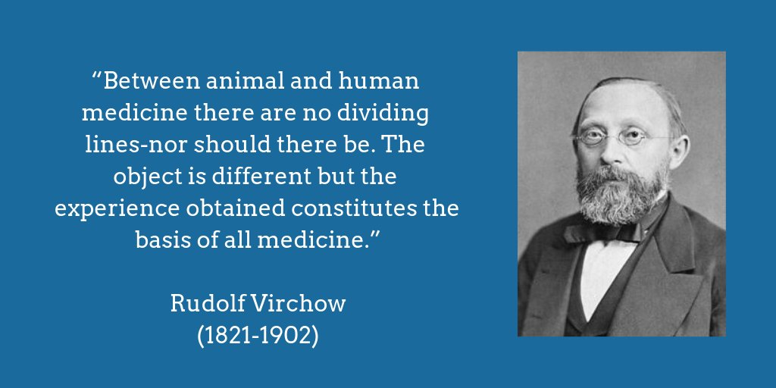
Evolution of One Health

Slide 12
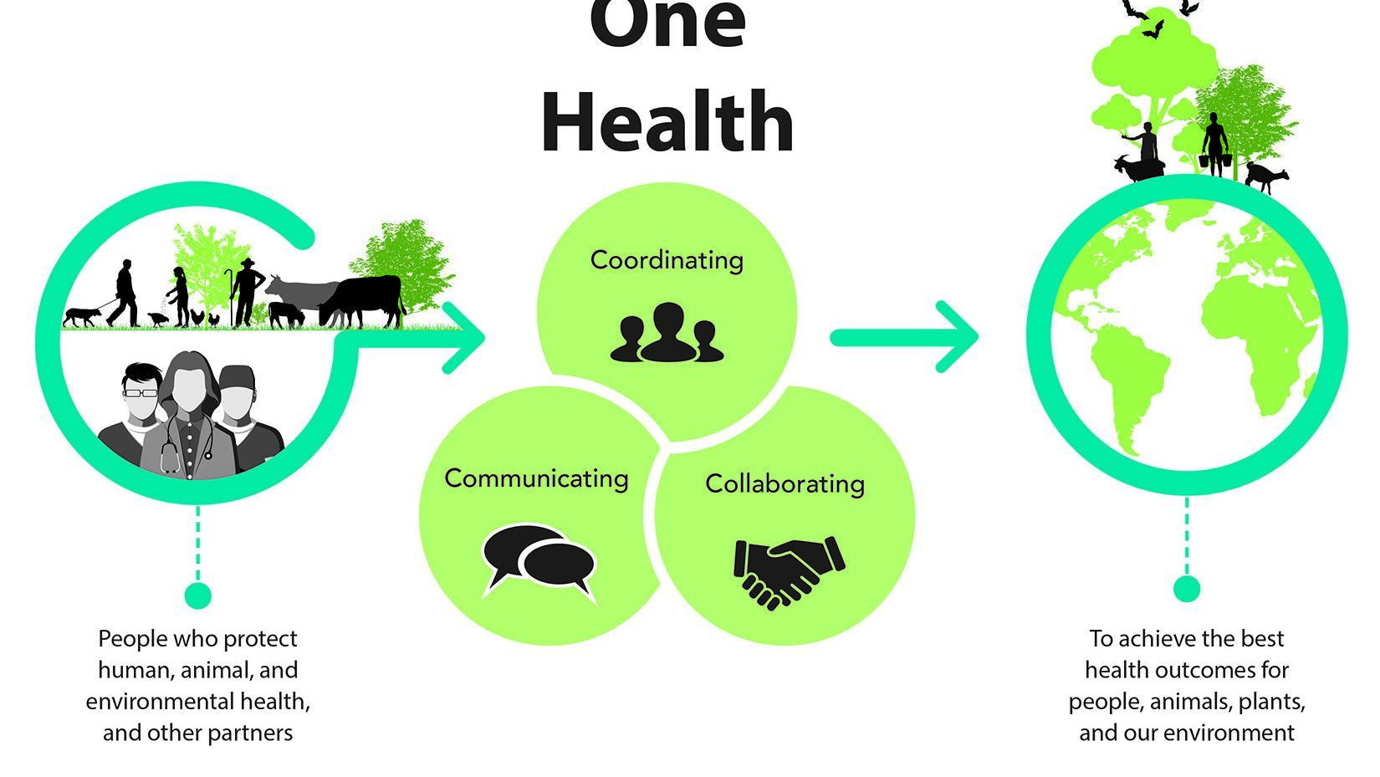
The Foundation of One Health Approach
One Health approach works by involving professionals in human health (doctors, nurses, public health practitioners, epidemiologists), animal health (veterinarians, paraprofessionals, agricultural workers), environment (ecologists, wildlife experts), and other areas of expertise need to communicate, collaborate on, and coordinate activities.
Multi sectoral partnerships to prevent, detect, and respond to health threats at the human-animal-environment interface. It is especially critical because of the region’s high burden of zoonotic diseases, climate risks, and dependence on livestock and natural resources.

Slide 13
One World, One Health Manhattan Principles
Recognize the essential link between human, domestic animal and wildlife health and the threat disease poses
Recognize that decisions regarding land and water use have real implications for health
Include wildlife health science as an essential component of global disease prevention, surveillance, monitoring, control and mitigation
Recognize that public health programs can greatly contribute to conservation efforts
Devise adaptive, holistic and forward-looking approaches to the prevention, surveillance, monitoring, control and mitigation of emerging and resurging diseases that take the complex interconnections among species into full account
Integrate biodiversity conservation perspectives and human needs when developing solutions to infectious disease threats
Reduce demand for and better regulate the international wildlife and bush meat trade
Restrict the mass culling of wildlife species for disease control
Increase investment in the global human and animal health infrastructure
Form collaborative relationships among governments, local people, and the private and public sectors
Provide adequate resources and support for global wildlife health surveillance
Invest in educating and raising awareness among the world's people

Slide 14
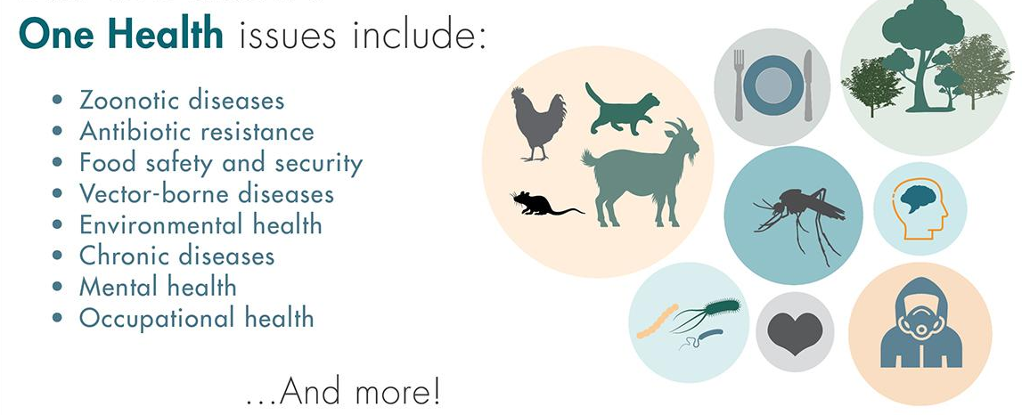
Major One Health issues

Slide 15
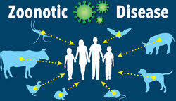
Zoonotic Diseases
The spread of existing or known (endemic) and new or emerging zoonotic diseases, which are diseases that can spread between animals and people. Every year, millions of people and animals around the world are affected by zoonotic diseases.
Examples of zoonotic diseases include:
Rabies
Salmonella infection
West Nile virus infection
Q Fever (Coxiella burnetii)
Anthrax
Brucellosis
Lyme disease
Ringworm
Ebola
COVID-19

Slide 16
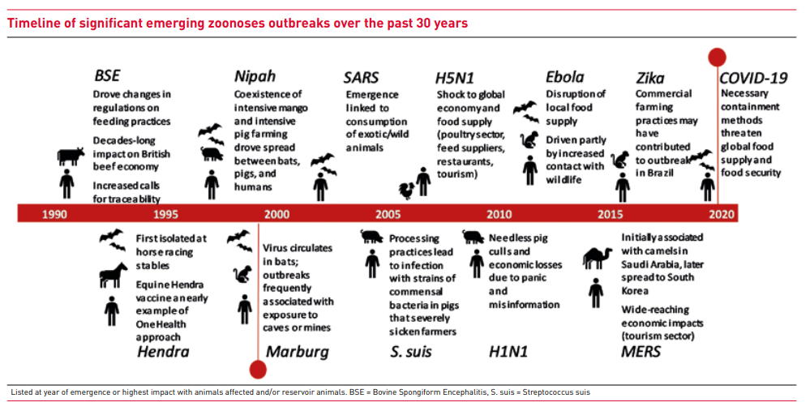

Slide 17
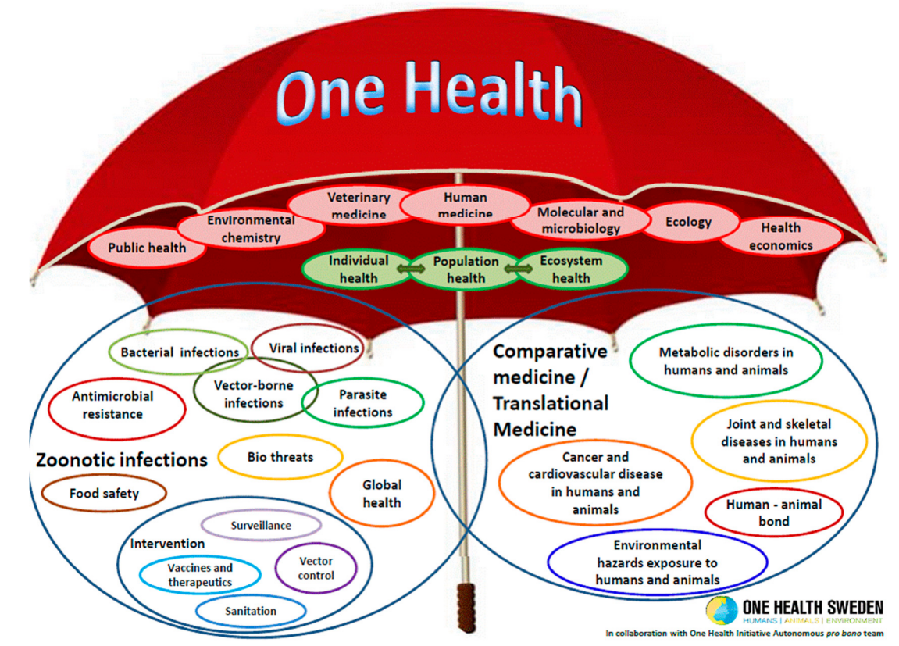
Notes:
The aim of One health is to;
1. To prevent outbreaks of zoonotic disease in animals and people
2. To improve food safety and security and economies reliant on livestock production
3. To reduce antibiotic-resistant infections and improve human and animal health
4. To protect global health security

Slide 18
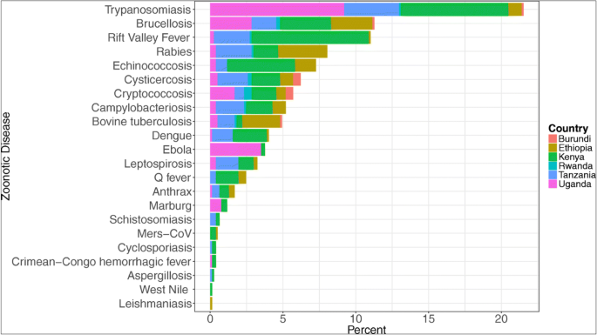
Zoonoses as a public health problem in East Africa

Slide 19
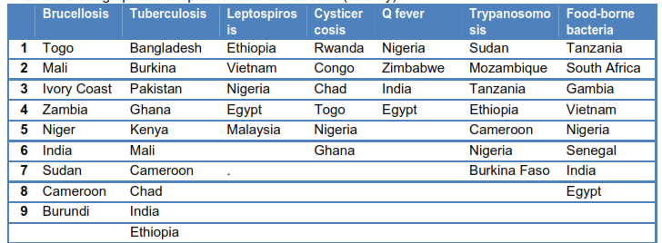
Zoonotic Disease Hotspots

Slide 20
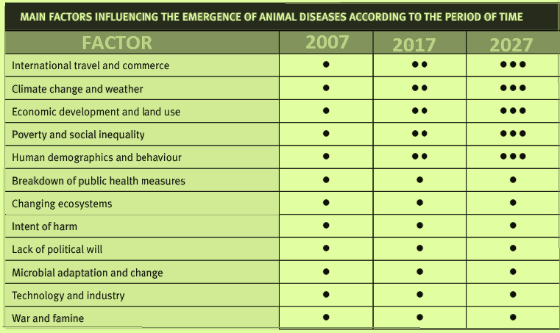
Factors influencing the emergency of animal disease overtime
FACTOR | 2007 | 2017 | 2027

Slide 21
Intersectoral Coordination for Prevention and control of Zoonoses
Kenya
Coordination Structure:
  Zoonotic Disease Unit (ZDU) (est. 2012) – joint Ministry of Health + Ministry of Agriculture/Livestock office.
  Oversees prevention, detection, and control of priority zoonoses.
Priority Zoonoses: Rabies, Rift Valley Fever, Brucellosis, Anthrax, Avian Influenza.
Mechanisms:
  Joint outbreak investigations.
  Integrated surveillance with health & veterinary systems.
  Annual joint trainings for vets, medics, and lab staff.
Successes:
  Rabies elimination strategy (2014–2030).
  Coordinated Rift Valley Fever preparedness plans.
Challenges:
  Funding gaps for rabies elimination.
  Fragmented data-sharing across counties.

Slide 22
Intersectoral Coordination for Prevention and control of Zoonoses
Uganda
Coordination Structure:
  Uganda National One Health Platform (NOHP) (2016), hosted at the Office of the Prime Minister.
  Brings together Ministries of Health, Agriculture/Animal Industry & Fisheries, Water & Environment, and Wildlife Authority.
Priority Zoonoses: Viral hemorrhagic fevers (Ebola, Marburg), Anthrax, Rabies, Brucellosis.
Mechanisms:
  Multisectoral rapid response teams during Ebola/Marburg outbreaks.
  Joint surveillance and simulation exercises.
  Community engagement for bushmeat and wildlife contact risks.
Successes:
Quick containment of Ebola outbreaks using OH coordination.
Challenges:
Limited capacity in district-level veterinary services.
Cross-border movements with DRC complicate surveillance.

Slide 23
Intersectoral Coordination for Prevention and control of Zoonoses
Tanzania
Coordination Structure:
  One Health Coordination Desk under the Prime Minister’s Office (2015).
  National One Health Strategic Plan developed.
Priority Zoonoses: Rabies, Rift Valley Fever, Brucellosis, Anthrax, Leptospirosis.
Mechanisms:
  Mass dog vaccination campaigns (One Health rabies elimination).
  Integrated zoonoses surveillance (labs & field).
  Joint contingency planning for RVF outbreaks.
Successes:
Tanzania part of “Zero by 30” global rabies elimination initiative.
Strengthened AMR coordination across human and livestock sectors.
Challenges:
Underfunded One Health coordination desk.
Weak links between wildlife and human health authorities.

Slide 24
Intersectoral Coordination for Prevention and control of Zoonoses
Ethiopia
Coordination Structure:
  National One Health Steering Committee (2017).
  Members: Ministries of Health, Livestock, Environment, and Wildlife.
  Supported by universities (Haramaya, Addis Ababa) and FAO/USAID.
Priority Zoonoses: Anthrax, Rabies, Brucellosis, Rift Valley Fever, Avian Influenza, Tuberculosis.
Mechanisms:
  Integrated rabies vaccination programs.
  AMR surveillance linking hospitals and farms.
  Training of health & vet professionals in One Health.
Successes:
  Joint response to anthrax outbreaks in pastoralist communities.
Challenges:
  Nomadic pastoralist systems make surveillance and vaccination coverage difficult.
  Fragmented reporting between health and livestock offices.

Slide 25
Intersectoral Coordination for Prevention and control of Zoonoses
Rwanda
Coordination Structure:
  Rwanda One Health Strategic Plan (2015–2020) – inter-ministerial.
  Led by Ministry of Health, Agriculture, and Environment.
Priority Zoonoses: Rabies, Brucellosis, Anthrax, Avian Influenza.
Mechanisms:
  Integrated disease reporting across human and animal sectors.
  One Health research incorporated into universities.
Successes:
  Early adoption of a national One Health policy framework.
Challenges:
  Limited resources to operationalize programs at community level.
South Sudan
Coordination Structure:
  Emerging One Health initiatives with FAO, WHO, and government agencies.
  Still under development due to fragility of health systems.
Priority Zoonoses: Rift Valley Fever, Brucellosis, Anthrax.
Challenges:
  Conflict and instability limit intersectoral coordination.
  Weak veterinary and lab systems.

Slide 26
Antimicrobial Resistance
Antimicrobial resistance (AMR) is the ability of a microbe to resist the effects of medication that once could successfully treat the microbe.
The term antibiotic resistance (AR or ABR) is a subset of AMR, as it applies only to bacteria becoming resistant to antibiotics.
Addressing the rising threat of AMR requires a holistic and multisectoral approach – referred to as One Health – because antimicrobials used to treat various infectious diseases in animals may be the same or similar to those used for humans.
Notes:
Resistant bacteria arising in humans, animals or the environment may spread from one to the other, and from one country to another.
AMR does not recognize geographic or human–animal borders.

Slide 27
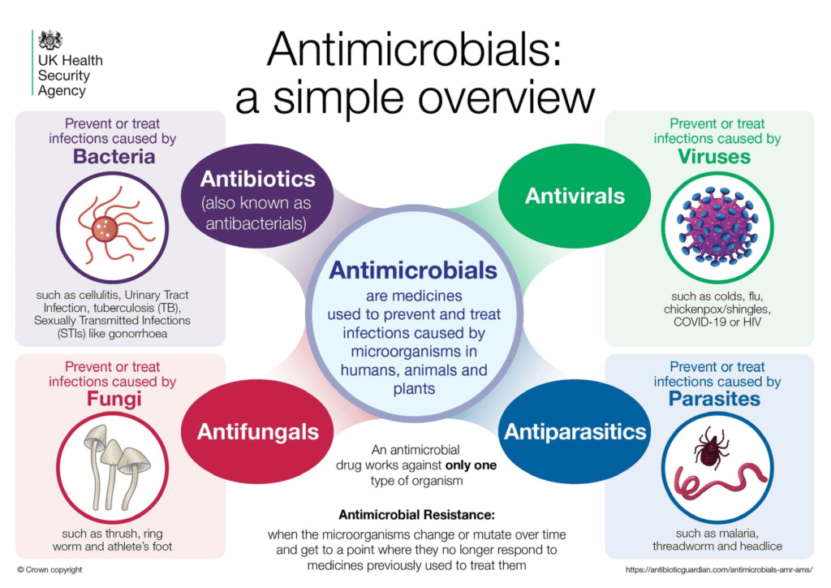
Antimicrobial Resistance
SOURCE: https://ukhsa.blog.gov.uk/2021/11/17/what-is-antimicrobial-resistance-and-why-do-we-need-to-take-action-against-it/

Slide 28
The Global Action Plan on AMR
The Global action plan sets out 5 strategic objectives:
To improve awareness and understanding of AMR.
To strengthen knowledge through surveillance and research.
To reduce the incidence of infection.
To optimize the use of antimicrobial agents.
To develop the economic case for sustainable investment that takes account of the needs of all countries and to increase investment in new medicines, diagnostic tools, vaccines and other interventions.

Slide 29
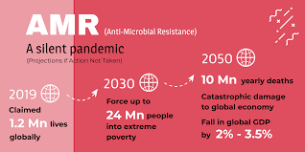
Global Review of AMR
https://connectheor.com/antimicrobial-resistance-a-threat-to-the-world-but-how-does-the-uks-netflix-style-payment-model-appeal-to-roll-out-new-antimicrobials-and-combat-amr/
Notes:
A global review of AMR and its future impact estimated that there would be 10 million global AMR deaths annually from the year 2050 if we do nothing to preserve our current effective antibiotics or do not develop new ones. [1] The GRAM report indicates that over 1.2 million people died in 2019 worldwide from infections caused by AMR. [2] Thus, establishing AMR as unequivocally a leading cause of death globally. The report also highlights that young children, particularly those under-fives, and those living in low-and middle-income countries as being particularly at risk.
AMR is currently killing more people annually than HIV/AIDS, Breast Cancer and Malaria, yet does not receive the coverage or funding implemented to tackle any of these diseases. AMR must be prioritized and necessitates an approach and investment to protect the future of our medications and prevent the unnecessary loss of millions of lives.

Slide 30
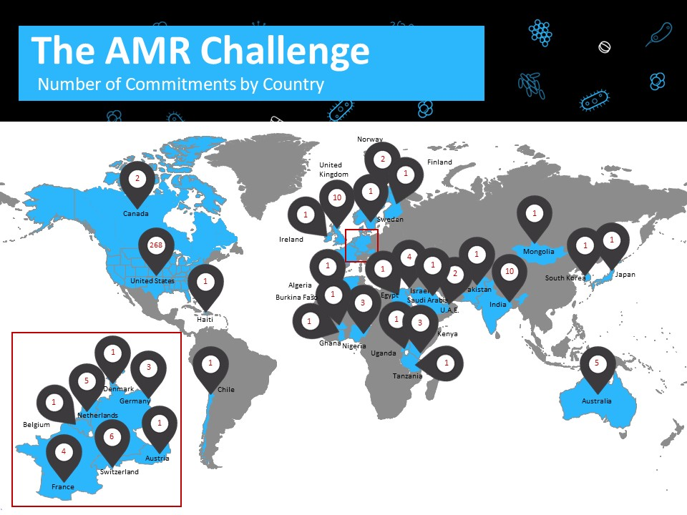

Slide 31
Food Safety, Food Security and Sustainable food production in One Health
The global human population is expected to reach 9.7 billion people by the year 2050.
By the year 2050, food production will need to increase by more than 50% of 2012 production levels to meet demand.
Likewise, consumers in developed countries have developed preferences for specialized products that are marketed as organic, fair-trade, or locally grown (Bellows et al., 2010; Feldmann and Hamm, 2015; O'Connor et al., 2017).
Notes:
Increased demand for food has already strained natural resources resulting in soil erosion, loss of biodiverse landscapes, and pollution of the environment all around the world presenting new challenges in food safety and sustainable food production (Tilman et al., 2011).

Slide 32
Food Safety, Food Security and Sustainable food production in One Health
Natural disasters such as fires and floods create routes in which pathogens, chemicals, heavy metals, and other pollutants can contaminate air, water, and the environment in which we live and grow food (Watson et al., 2007; Knorr et al., 2017; Wu et al., 2017; Andrade et al., 2018).
Globalization and easy access to rapid travel has made transboundary diseases a top concern for food safety and food security. (Otte et al., 2004).
Sometimes these diseases can be zoonotic and pose a public health risk.
Notes:
Transboundary diseases are highly contagious animal diseases that cause a high morbidity and mortality in animals.
Outbreaks of transboundary disease are economically devastating for farmers and have significant impact on the cost and availability of food

Slide 33
WHO 10 Golden Rules for Safe Food Preparation
WHO data indicate that only a small number of factors related to food handling are responsible for a large proportion of foodborne disease episodes everywhere.
Common errors include:
  preparation of food several hours prior to consumption, combined with its storage at temperatures which favour growth of pathogenic bacteria and/or formation of toxins;
  insufficient cooking or reheating of food to reduce or eliminate pathogens;
  cross contamination; and
  people with poor personal hygiene handling the food.
The Ten Golden Rules respond to these errors, offering advice that can reduce the risk that foodborne pathogens will be able to contaminate, to survive or to multiply.

Slide 34
WHO 10 Golden Rules for Safe Food Preparation
Choose food processed for safety
Cook food thoroughly
Eat cooked foods immediately
Store cooked foods carefully
Reheat cooked foods thoroughly
Avoid contact between raw foods and cooked foods
Wash hands repeatedly
Keep all kitchen surfaces meticulously clean
Protect foods from insects, rodents and other animals
Use safe water

Slide 35
Veterinarians in One Health
Role of Veterinarians | They are at the frontline of One Health, bridging human, animal, and environmental health to prevent future pandemics and promote sustainability.
Zoonotic Disease Control | Detect, prevent, and manage diseases that pass between animals and humans (e.g., rabies, avian influenza, brucellosis).
Food Safety & Security | Ensure safe livestock production, meat inspection, and antimicrobial stewardship. Support sustainable animal husbandry that contributes to nutrition and livelihoods.
Environmental Health | Monitor and mitigate impacts of livestock and wildlife on ecosystems. Contribute to biodiversity conservation and climate change adaptation strategies.
Public Health Collaboration | Work alongside medical doctors, ecologists, and policymakers to prevent outbreaks. Participate in surveillance systems and emergency response.
Education & Community Engagement | Train farmers and communities on biosecurity, vaccination, and responsible antibiotic use. Advocate for integrated One Health policies.

Slide 36
Challenges
High Human–Animal Contact | Large populations interact closely with pets and farm animals, creating hotspots for emerging zoonotic diseases.
Weak Surveillance Systems | Limited monitoring and reporting of animal diseases. Insufficient laboratory capacity for timely diagnosis.
Limited Cross-Sector Support | Weak involvement of medical professionals in setting up animal and zoonotic disease surveillance programs.
Neglected Zoonoses | Mild or low-to-medium risk zoonotic diseases often go unmonitored, yet can escalate into major outbreaks if ignored. Wildlife-related zoonoses receive little attention.
Low Awareness | Communities and even professionals often lack awareness of zoonotic risks and preventive measures.
Poor Coordination | Insufficient collaboration among stakeholders. No standardized One Health protocols widely adopted or implemented.

Slide 37
Wayforward
Strengthen Surveillance
Ensure strict monitoring of animal health.
Track emerging outbreaks at national, regional, and global levels.
Build Interdisciplinary Networks
Foster collaboration among veterinarians, medical doctors, environmental scientists, and policymakers.
Improve surveillance and response through coordinated partnerships.
Raise Awareness
Promote the One Health approach among farmers, livestock managers, and environmental practitioners.
Engage communities through training and outreach programs.
Develop a National Zoonotic Disease Registry
Standardize data collection, reporting, and sharing.
Strengthen evidence-based decision-making.
Leverage Technology
Use digital platforms, mobile apps, and GIS tools for early detection, reporting, and rapid response.
Focus on Prevention
Expand vaccination coverage for animals and at-risk human populations.
Promote biosecurity and hygiene practices in farms and households.
Adopt Best Practices
Develop context-specific One Health guidelines.
Institutionalize protocols across all sectors.

Slide 38
Conclusion
Infrastructure & Expertise
Adequate infrastructure & expertise (national, local, entry points)
Sustainable laboratory capacity + quality assurance
Surveillance & Monitoring
Timely animal & human surveillance systems
Monitoring & evaluation for Vet & Public Health
Communication protocol across sectors
Preparedness & Response
Up-to-date emergency response plans
Continuous biosecurity evaluation & improvement
Governance & Standards
Apply international agreements & standards (IHR, OIE, Codex)
Governance & legislation aligned with global standards

Slide 39

Take Home Message
Today’s health problems are frequently complex, transboundary, multifactorial, and across species
If approached from a purely medical, veterinary, or ecological standpoint, it is unlikely that sustainable mitigation strategies will be produced
One Health Approach is the only way forward to solve these issues

Slide 40
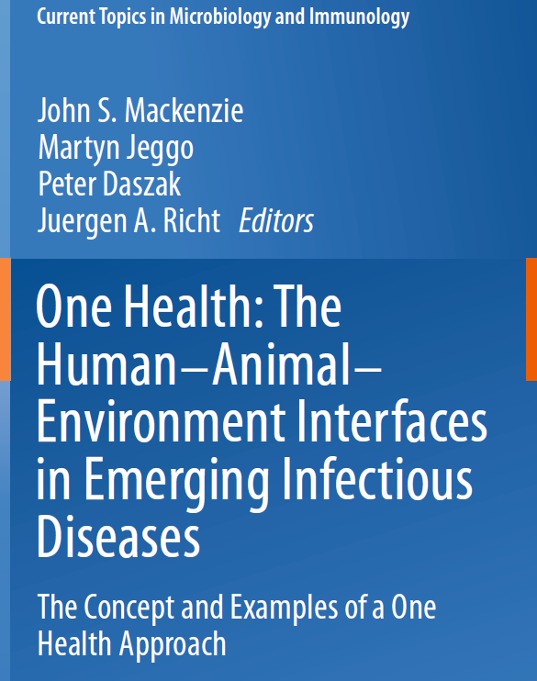
THANK YOU!

